Slide 1
Food Trends Understanding Customer Preferences in Foods and Beverages
Infosys Springboard Internship 6.0 | Final Project Presentation
Project mentor - Ajay .
Ambashree Ashwini Pathe Gorty Sree Naga Venkata Sravani Hardik Pandey G nana teja sri Manikanta Gedda Burgala Swathi D A AJAY Appapurapu S

Slide 2


Project Overview
An interactive Power BI dashboard project
Focus on food consumption, nutrition, and lifestyle patterns
Converts raw data into actionable insights
Helps understand customer preferences and health impact

Slide 3

Project Statement
Modern lifestyles have led to imbalanced dietary habits and excessive calorie consumption, increasing the risk of obesity and chronic diseases
There is limited visibility into how macronutrient intake (carbohydrates, proteins, fats) affects overall health outcomes and BMI levels.
Individuals often lack awareness of the relationship between physical activity levels and calorie balance.
Understanding how dietary preferences influence disease risk remains challenging without structured data analysis.
There is a need for an interactive system to analyze nutrition patterns, lifestyle behavior, and health indicators together in one platform.

Slide 4
Project objectives
To analyze calorie intake and macronutrient distribution across different meal types and dietary preference
To evaluate the relationship between physical activity levels and BMI variations.
identify patterns linking dietary habits with disease risk categories.
To examine how breakfast choices influence daily nutrition balance and health outcomes.
To develop an interactive Power BI dashboard that transforms raw nutrition data into actionable health insights for better lifestyle decision-making.

Slide 5

Data & Tech Stack
Data Includes | Tools Used
Food items, meal types | Microsoft Power BI
Calories, protein, carbs, fat | Power Query
Age, gender, activity level | DAX
BMI, dietary preferences | Excel

Slide 6

Data Sources & Processing
Dataset Link - https://www.kaggle.com/datasets/adilshamim8/daily-food-and-nutrition-dataset/data
https://www.kaggle.com/datasets/adilshamim8/daily-food-and-nutrition-dataset/data
Integrated multiple Kaggle datasets for comprehensive nutrition analysis.
Combined daily dietary intake with disease-specific diet recommendations.
Analyzed key nutritional metrics including calories, protein, and macronutrients.
Applied data cleaning and preprocessing techniques using Python for reliable insights.

Slide 7

DAX Implementation
Total Calories Intake – Overall daily energy consumption
Protein Intake (g) – Nutritional strength analysis
Carbohydrates & Fats % – Macronutrient distribution insights
Calorie Deficit/Surplus – Diet balance tracking
BMI (Body Mass Index) – Health status classification (Underweight / Normal / Overweight)
Meal-wise Analysis – Breakfast, Lunch, Dinner comparison
Healthy vs Unhealthy Food – Nutritional classification
Top Consumed Foods – Frequency-based insights
Sugar & Fiber Intake – Diet quality evaluation
Daily Trend Analysis – Consumption patterns over time

Slide 8

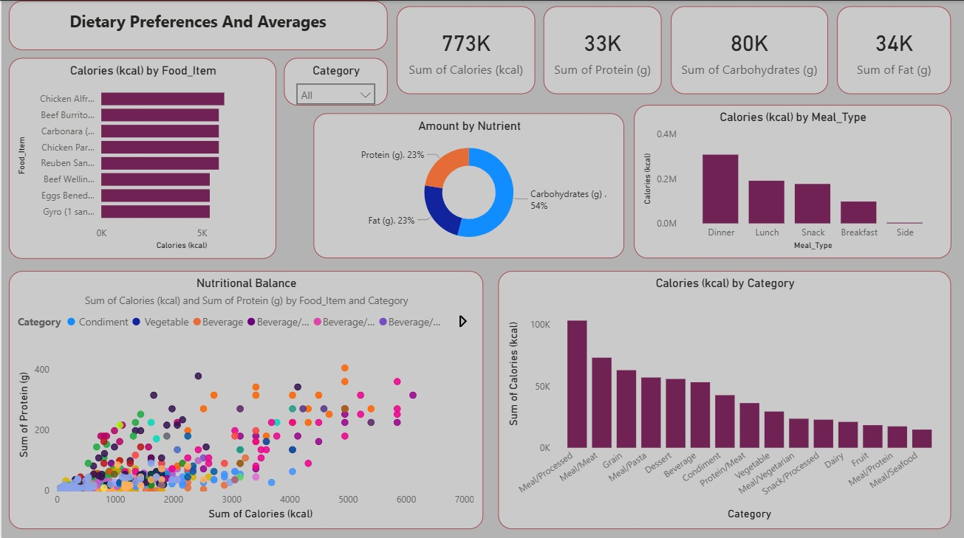
Dietary Preferences & Averages
Dashboard Overview
The dataset contains 773K total calories, with carbohydrates contributing the highest share (54%), followed by protein (23%) and fat (23%), indicating a carb-dominant dietary pattern.
Dinner contributes the highest calorie intake compared to breakfast, lunch, snacks, and sides, showing people consume most calories later in the day.
Meat-based protein sources contribute the largest calorie share among food categories.
Items like chicken, beef, and burritos appear among the highest calorie food choices.
Categories such as condiments and vegetables contribute minimal calories, suggesting low caloric impact but possible micronutrient importance.
The nutrient scatter plot shows a strong positive relationship between calories and protein, meaning higher-calorie foods tend to contain more protein.

Slide 9
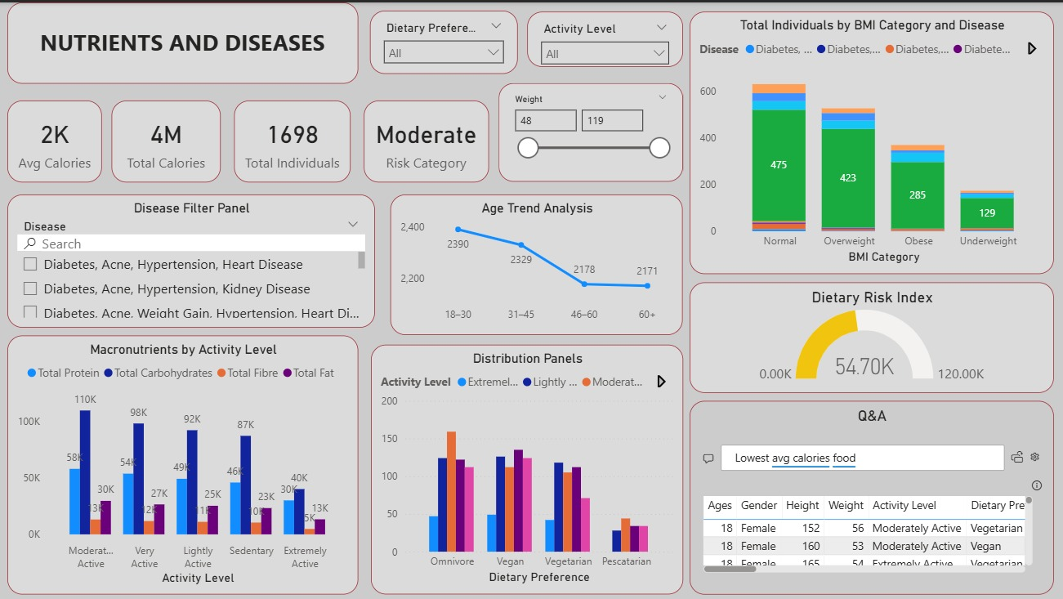
Nutrients & Diseases
The dataset includes 1,698 individuals with an average intake of 2K calories, categorized overall under moderate health risk.
Most individuals fall under the normal BMI category (475 people), followed by overweight and obese groups.
Disease prevalence increases as BMI increases, showing a clear relationship between BMI level and disease occurrence.
Moderately active individuals consume the highest macronutrient totals, especially carbohydrates and protein.
Activity level significantly affects nutrient distribution across dietary preferences.
The Dietary Risk Index value (54.70K) suggests moderate nutritional risk across the population.
Age trend analysis shows calorie intake gradually decreases after age 30.

Slide 10
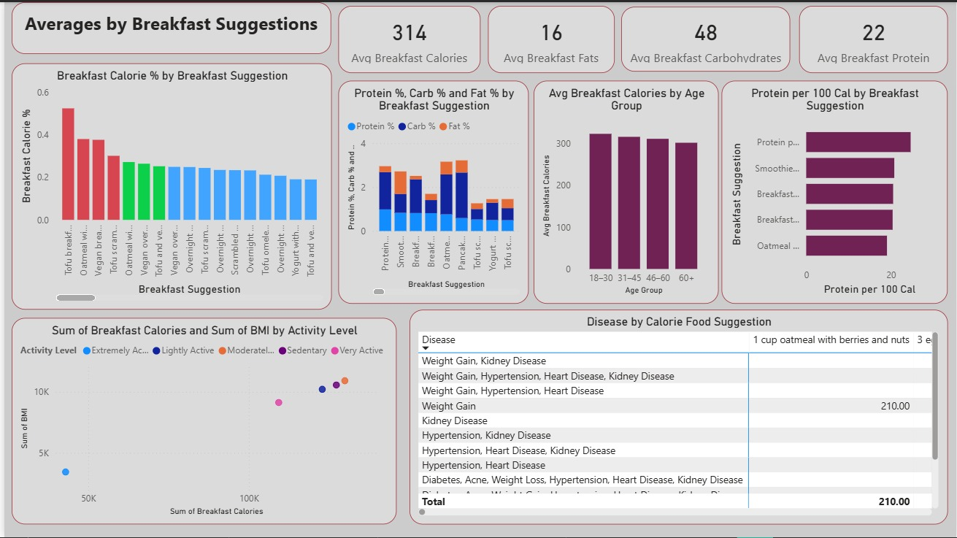
Breakfast Suggestions
The average breakfast contains 314 calories, 48g carbohydrates, 22g protein, and 16g fat, indicating balanced macronutrient composition.
Traditional breakfast items contribute the highest calorie percentage, followed by smoothies and bread-based meals.
Protein-rich breakfasts provide higher protein per 100 calories, making them efficient for energy balance.
Breakfast calorie intake remains consistent across all age groups, suggesting stable morning eating habits.
Higher breakfast calorie intake correlates with higher BMI values in less active individuals.
Some breakfast suggestions (like oatmeal with nuts and berries) are linked with lower disease association scores, indicating healthier options.

Slide 11
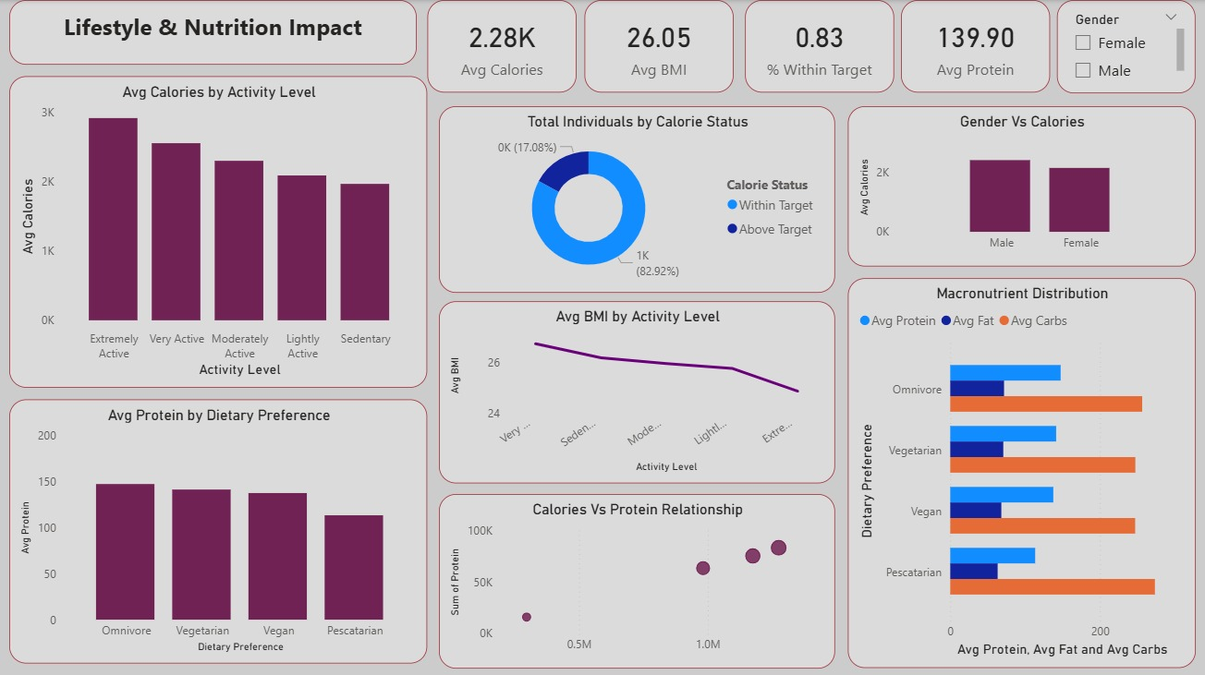
Lifestyle & Nutrition Impact
he average calorie intake across individuals is 2.28K calories, with an average BMI of 26.05, indicating slightly overweight population trends.
Only 17.08% of individuals meet target calorie intake, while 82.92% exceed recommended limits, suggesting widespread overconsumption.
Extremely active individuals consume the highest calories, while sedentary individuals consume the least.
Average BMI decreases as activity level increases, highlighting the importance of physical activity in weight management.
Omnivores consume the highest average protein, followed by vegetarians and vegans.
Macronutrient distribution shows carbohydrates dominate across all dietary preferences.
A strong positive relationship exists between total calorie intake and protein consumption, confirming higher calorie diets include higher protein intake.
Males consume slightly more calories than females, indicating gender-based dietary variation.

Slide 12

Conclusion
This project analyzes customer food preferences by linking diet, nutrition, and lifestyle factors.
It highlights that calorie intake, dietary choices, and activity levels directly impact health outcomes like BMI.
These insights can help in making better health decisions and improving food-related business strategies.

Slide 13
Thank You !!

